Slide 1
Timetable Automation System
Using Genetic Algorithm
Department of Computer Science & Engineering
School of Electrical and Computer Sciences IIT Bhubaneswar
Presented By
Nali Bhavana
Puvvula Nikhileswari

Slide 2
What is the problem?
Why Genetic Algorithms?
Creating a class timetable is a complex problem due to multiple constraints.
It’s classified as an NP-hard problem.
Heuristic methods struggle with complexity.
Genetic Algorithms efficiently search for optimal solutions in large, complex problem spaces.

Slide 3
Problem Statement
Goal:
Create a class schedule satisfying:
Classroom availability.
Non-overlapping schedules for professors and student groups.
Classroom capacity and equipment requirements.
Challenges:
High complexity with many constraints.
Multiple stakeholders’ preferences.

Slide 4
Scheduling Constraints
Classes only in available classrooms.
No overlap in professor or student schedules.
Classroom capacity must accommodate all students.
Necessary equipment (e.g., computers for labs) must be available.

Slide 5
Genetic Algorithm Overview
Purpose: A search heuristic to solve optimization problems.
WorkFlow:
1. Initialize Population: Generate random schedules (chromosomes).
2. Evaluate Fitness: Measure constraint satisfaction.
3. Selection: Choose best solutions for reproduction.
4. Crossover: Combine solutions for new schedules.
5. Mutation: Randomly adjust to increase diversity.

Slide 6
Chromosome Representation
Definition:
A chromosome represents a schedule.
Structure:
Each gene = class with time, room, and duration.
Time-Space Matrix maps rooms and time slots.
Example:
Gene: (Class: Math, Room: A, Duration: 1 Hour)

Slide 7
Fitness Function
Purpose: Quantify schedule quality.
Penalized Violations:
Room conflicts.
Overlapping professor or student schedules.
Capacity mismatches.

Slide 8
Crossover and Mutation
Crossover:
Combine two schedules to create better offspring.
Ensures good traits are inherited.
Mutation:
Randomly modify class times or rooms.
Maintains diversity to avoid local optima.

Slide 9
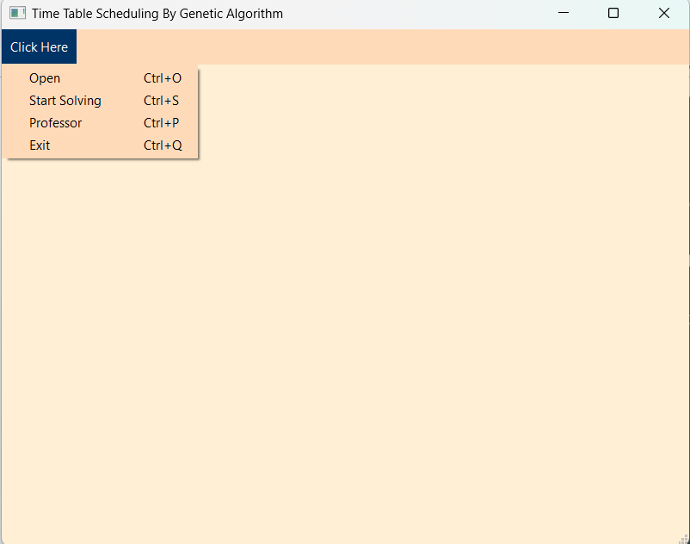
Results
Input Configuration File Format
Types of objects:
professor (#prof tag) - describes a professor.
course (#course tag) - describes a course.
room (#room tag) - describes a room.
group (#group tag) - describes a students group.
course class (#class tag) - describes a class, and binds the professor, course, and students group.

Slide 10
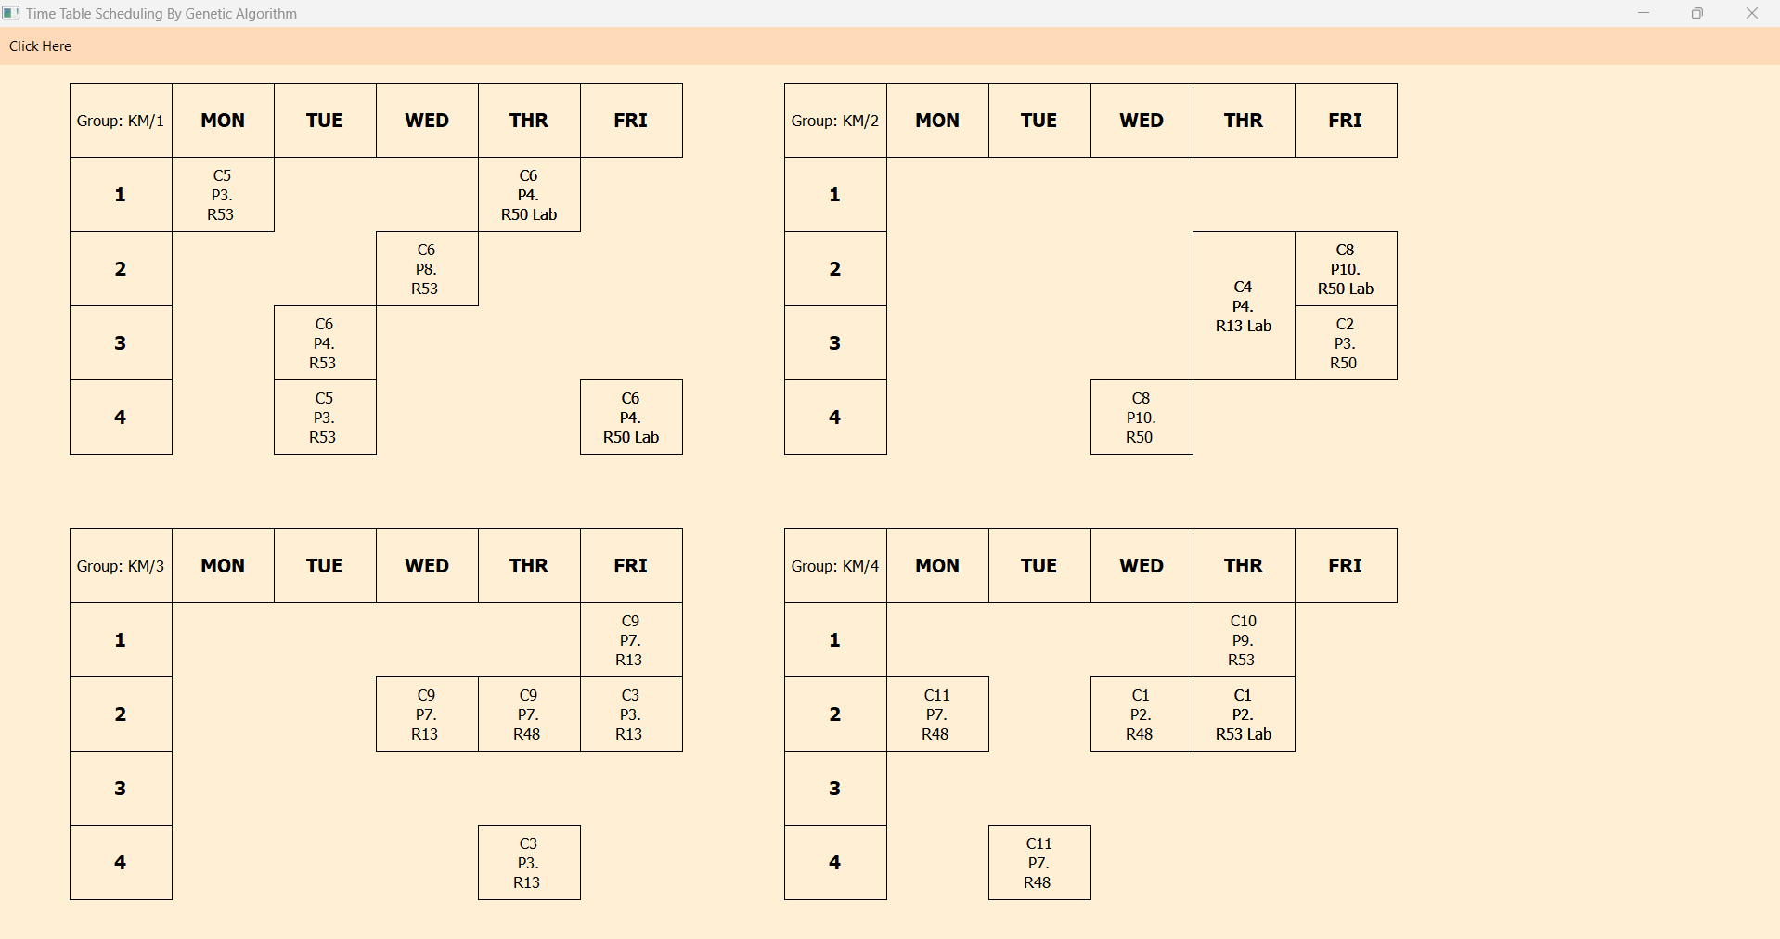
Results

Slide 11
Future Enhancements
Integrate database for real-time scheduling updates.
Add visualization tools for better schedule insights.
Optimize genetic algorithm parameters (e.g., mutation rate).

Slide 12
Thank You

